Slide 1
The lecture 10
Data warehouses and olap

Slide 2
What is a Data Warehouse?
Defined in many different ways, but not rigorously.
  A decision support database that is maintained separately from the organization’s operational database
  Support information processing by providing a solid platform of consolidated, historical data for analysis.
“A data warehouse is a subject-oriented, integrated, time-variant, and nonvolatile collection of data in support of management’s decision-making process.”—W. H. Inmon
Data warehousing:
  The process of constructing and using data warehouses

Slide 3
Data Warehouse—Subject-Oriented
Organized around major subjects, such as customer, product, sales
Focusing on the modeling and analysis of data for decision makers, not on daily operations or transaction processing
Provide a simple and concise view around particular subject issues by excluding data that are not useful in the decision support process

Slide 4
Data Warehouse—Integrated
Constructed by integrating multiple, heterogeneous data sources
  relational databases, flat files, on-line transaction records
Data cleaning and data integration techniques are applied.
  Ensure consistency in naming conventions, encoding structures, attribute measures, etc. among different data sources
    E.g., Hotel price: currency, tax, breakfast covered, etc.
  When data is moved to the warehouse, it is converted.

Slide 5
Data Warehouse—Time Variant
The time horizon for the data warehouse is significantly longer than that of operational systems
  Operational database: current value data
  Data warehouse data: provide information from a historical perspective (e.g., past 5-10 years)
Every key structure in the data warehouse
  Contains an element of time, explicitly or implicitly
  But the key of operational data may or may not contain “time element”

Slide 6
Data Warehouse—Nonvolatile
A physically separate store of data transformed from the operational environment
Operational update of data does not occur in the data warehouse environment
  Does not require transaction processing, recovery, and concurrency control mechanisms
  Requires only two operations in data accessing:
    initial loading of data and access of data

Slide 7
OLTP vs. OLAP

Slide 8
Why a Separate Data Warehouse?
High performance for both systems
  DBMS— tuned for OLTP: access methods, indexing, concurrency control, recovery
  Warehouse—tuned for OLAP: complex OLAP queries, multidimensional view, consolidation
Different functions and different data:
  missing data: Decision support requires historical data which operational DBs do not typically maintain
  data consolidation: DS requires consolidation (aggregation, summarization) of data from heterogeneous sources
  data quality: different sources typically use inconsistent data representations, codes and formats which have to be reconciled
Note: There are more and more systems which perform OLAP analysis directly on relational databases

Slide 9
Data Warehouse: A Multi-Tiered Architecture
Monitor
&
Integrator
OLAP Server
Other
sources
Metadata
Analysis
Query
Reports
Data mining
Operational
DBs
Extract
Transform
Load
Refresh
Data
Warehouse
Serve
Data Marts
Data Sources
Data Storage
OLAP Engine
Front-End Tools

Slide 10
Three Data Warehouse Models
Enterprise warehouse
  collects all of the information about subjects spanning the entire organization
Data Mart
  a subset of corporate-wide data that is of value to a specific groups of users. Its scope is confined to specific, selected groups, such as marketing data mart
    Independent vs. dependent (directly from warehouse) data mart
Virtual warehouse
  A set of views over operational databases
  Only some of the possible summary views may be materialized

Slide 11
Extraction, Transformation, and Loading (ETL)
Data extraction
  get data from multiple, heterogeneous, and external sources
Data cleaning
  detect errors in the data and rectify them when possible
Data transformation
  convert data from legacy or host format to warehouse format
Load
  sort, summarize, consolidate, compute views, check integrity, and build indicies and partitions
Refresh
  propagate the updates from the data sources to the warehouse

Slide 12
Metadata Repository
Meta data is the data defining warehouse objects. It stores:
Description of the structure of the data warehouse
  schema, view, dimensions, hierarchies, derived data defn, data mart locations and contents
Operational meta-data
  data lineage (history of migrated data and transformation path), currency of data (active, archived, or purged), monitoring information (warehouse usage statistics, error reports, audit trails)
The algorithms used for summarization
The mapping from operational environment to the data warehouse
Data related to system performance
  warehouse schema, view and derived data definitions
Business data
  business terms and definitions, ownership of data, charging policies

Slide 13
Data Warehousing and On-line Analytical Processing
Data Warehouse: Basic Concepts
Data Warehouse Modeling: Data Cube and OLAP
Data Warehouse Design and Usage
Data Warehouse Implementation
Data Generalization by Attribute-Oriented Induction
Summary

Slide 14
From Tables and Spreadsheets to
Data Cubes
A data warehouse is based on a multidimensional data model which views data in the form of a data cube
A data cube, such as sales, allows data to be modeled and viewed in multiple dimensions
  Dimension tables, such as item (item_name, brand, type), or time(day, week, month, quarter, year)
  Fact table contains measures (such as dollars_sold) and keys to each of the related dimension tables
In data warehousing literature, an n-D base cube is called a base cuboid. The top most 0-D cuboid, which holds the highest-level of summarization, is called the apex cuboid. The lattice of cuboids forms a data cube.

Slide 15
Cube: A Lattice of Cuboids
all
0-D (apex) cuboid
time
item
location
supplier
1-D cuboids
time,location
item,location
location,supplier
2-D cuboids
time,item
time,supplier
item,supplier
time,location,supplier
3-D cuboids
time,item,location
item,location,supplier
time,item,supplier
4-D (base) cuboid
time, item, location, supplier

Slide 16
Conceptual Modeling of Data Warehouses
Modeling data warehouses: dimensions & measures
  Star schema: A fact table in the middle connected to a set of dimension tables
  Snowflake schema: A refinement of star schema where some dimensional hierarchy is normalized into a set of smaller dimension tables, forming a shape similar to snowflake
  Fact constellations: Multiple fact tables share dimension tables, viewed as a collection of stars, therefore called galaxy schema or fact constellation

Slide 17
Example of Star Schema
time
time_key
day
day_of_the_week
month
quarter
year
item
item_key
item_name
brand
type
supplier_type
Sales Fact Table
time_key
item_key
branch_key
branch
location
location_key
branch_key
branch_name
branch_type
location_key
street
city
state_or_province
country
units_sold
dollars_sold
avg_sales
Measures

Slide 18
Example of Snowflake Schema
time
item
time_key
day
day_of_the_week
month
quarter
year
item_key
item_name
brand
type
supplier_key
supplier
Sales Fact Table
supplier_key
supplier_type
time_key
item_key
branch_key
branch
location
location_key
location_key
street
city_key
branch_key
branch_name
branch_type
units_sold
dollars_sold
city
city_key
city
state_or_province
country
avg_sales
Measures

Slide 19
Example of Fact Constellation
time
time_key
day
day_of_the_week
month
quarter
year
item
Shipping Fact Table
item_key
item_name
brand
type
supplier_type
Sales Fact Table
time_key
time_key
item_key
shipper_key
item_key
branch_key
from_location
branch
location_key
location
to_location
branch_key
branch_name
branch_type
units_sold
location_key
street
city
province_or_state
country
dollars_cost
dollars_sold
units_shipped
avg_sales
shipper
Measures
shipper_key
shipper_name
location_key
shipper_type

Slide 20
A Concept Hierarchy: Dimension (location)
all
all
region
Europe
...
North_America
country
Germany
...
Spain
Canada
...
Mexico
city
Frankfurt
...
Vancouver
...
Toronto
office
L. Chan
...
M. Wind

Slide 21
Data Cube Measures: Three Categories
Distributive: if the result derived by applying the function to n aggregate values is the same as that derived by applying the function on all the data without partitioning
    E.g., count(), sum(), min(), max()
Algebraic: if it can be computed by an algebraic function with M arguments (where M is a bounded integer), each of which is obtained by applying a distributive aggregate function
    E.g., avg(), min_N(), standard_deviation()
Holistic: if there is no constant bound on the storage size needed to describe a subaggregate.
    E.g., median(), mode(), rank()

Slide 22
Multidimensional Data
Sales volume as a function of product, month, and region
Dimensions: Product, Location, Time
Hierarchical summarization paths
Region
Industry Region Year
Category Country Quarter
Product City Month Week
Office Day
Product
Month

Slide 23
A Sample Data Cube
Date
Total annual sales
of TVs in U.S.A.
1Qtr
2Qtr
3Qtr
4Qtr
sum
Product
TV
PC
U.S.A
VCR
sum
Canada
Country
Mexico
sum
All, All, All

Slide 24
Cuboids Corresponding to the Cube
all
0-D (apex) cuboid
product
date
country
1-D cuboids
product,date
product,country
date, country
2-D cuboids
3-D (base) cuboid
product, date, country

Slide 25
Typical OLAP Operations
Roll up (drill-up): summarize data
  by climbing up hierarchy or by dimension reduction
Drill down (roll down): reverse of roll-up
  from higher level summary to lower level summary or detailed data, or introducing new dimensions
Slice and dice: project and select
Pivot (rotate):
  reorient the cube, visualization, 3D to series of 2D planes
Other operations
  drill across: involving (across) more than one fact table
  drill through: through the bottom level of the cube to its back-end relational tables (using SQL)

Slide 26
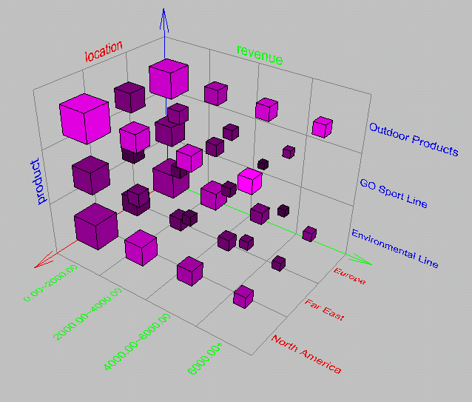
Browsing a Data Cube
Visualization
OLAP capabilities
Interactive manipulation

